Slide 1
Design Lab -1
INDIAN INSTITUTE OF TECHNOLOGY ROPAR
To study the change in response of a polymer to an applied load with temperature

Slide 2
RAHUL KUMAWAT
Roll No. - 2020MEB1306
Email – 2020meb1306@iitrpr.ac.in

Slide 3
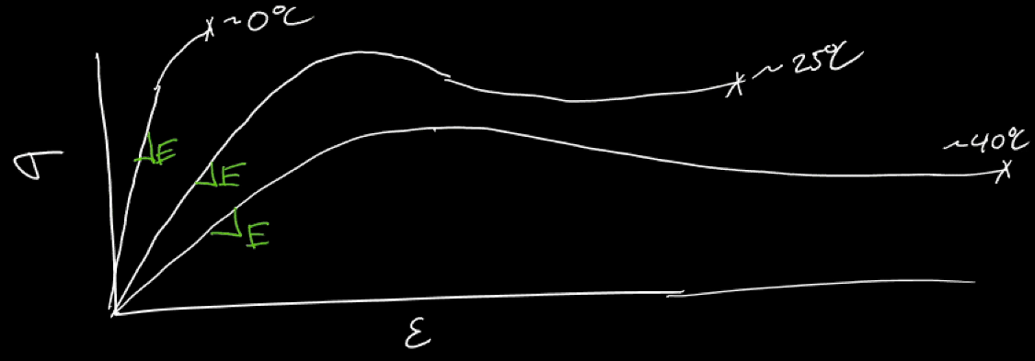
Change in Stress vs Strain Graph of polymer with temperature
As we see from the graph theoretically the strain of the polymer increases as we increase the temperature and as for stress it decreases with increase in temperature.

Slide 4
Strain we got from experiment at 31 degree celsius
Length of Sample taken : 8 cm
Length of Sample after tensile testing : 11.43 cm
Hence Strain we got is = (11.43-8)/8 = 0.4287

Slide 5
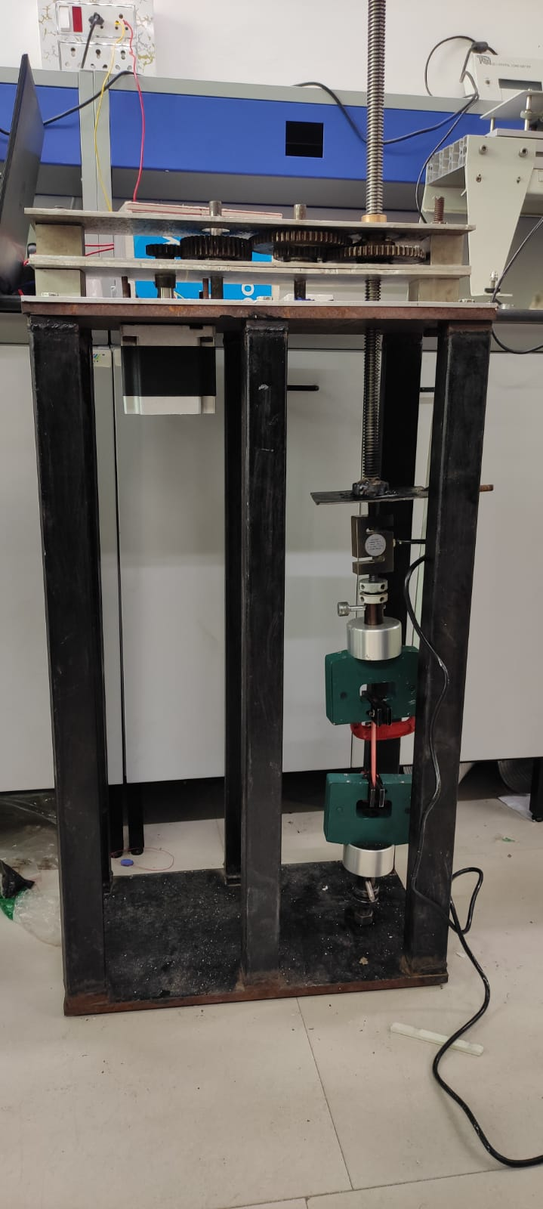
Equipments used to make a working UTM with a facility to tensile polymer at different temperatures
1 . NEMA 34 CNC stepper motor
2. Gears
3. Shaft and Metal frame
4. Load Cell (500 kg)
5. Clamps
6. PID Controller
7. Arduino UNO and HX711 module

Slide 6
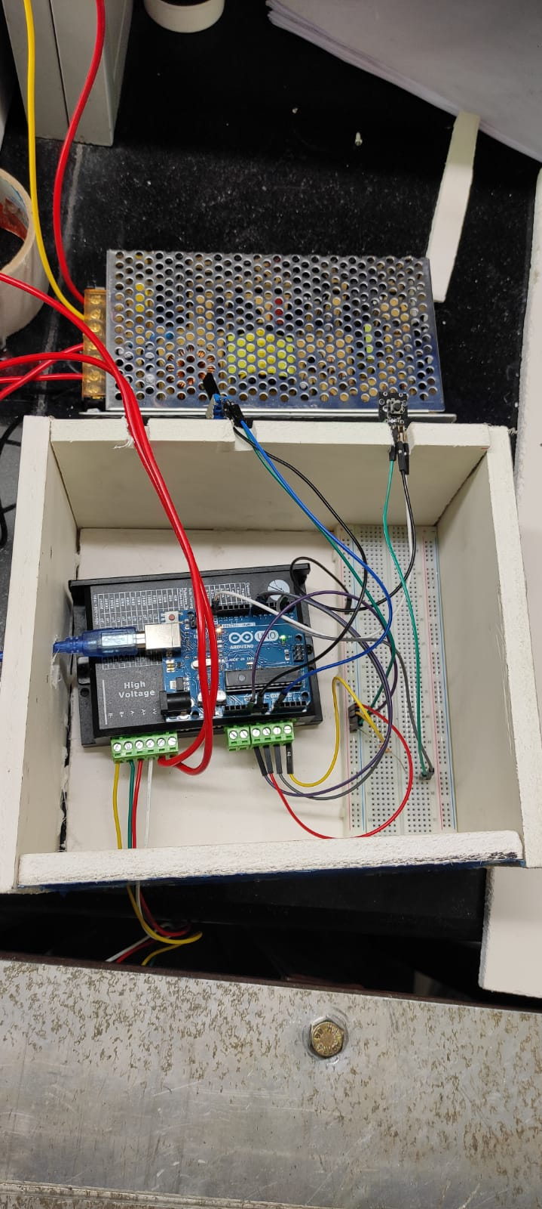
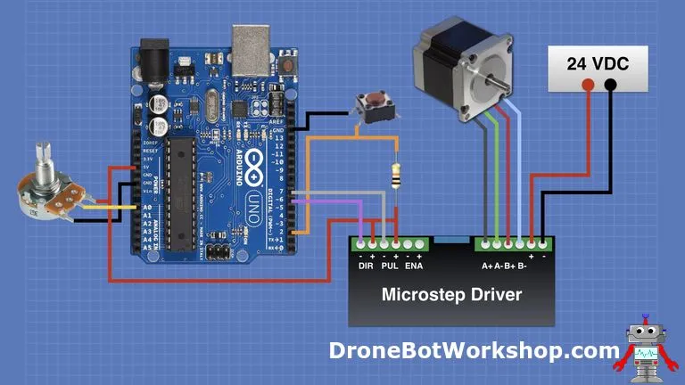
NEMA 34 CNC Stepper motor

Slide 7
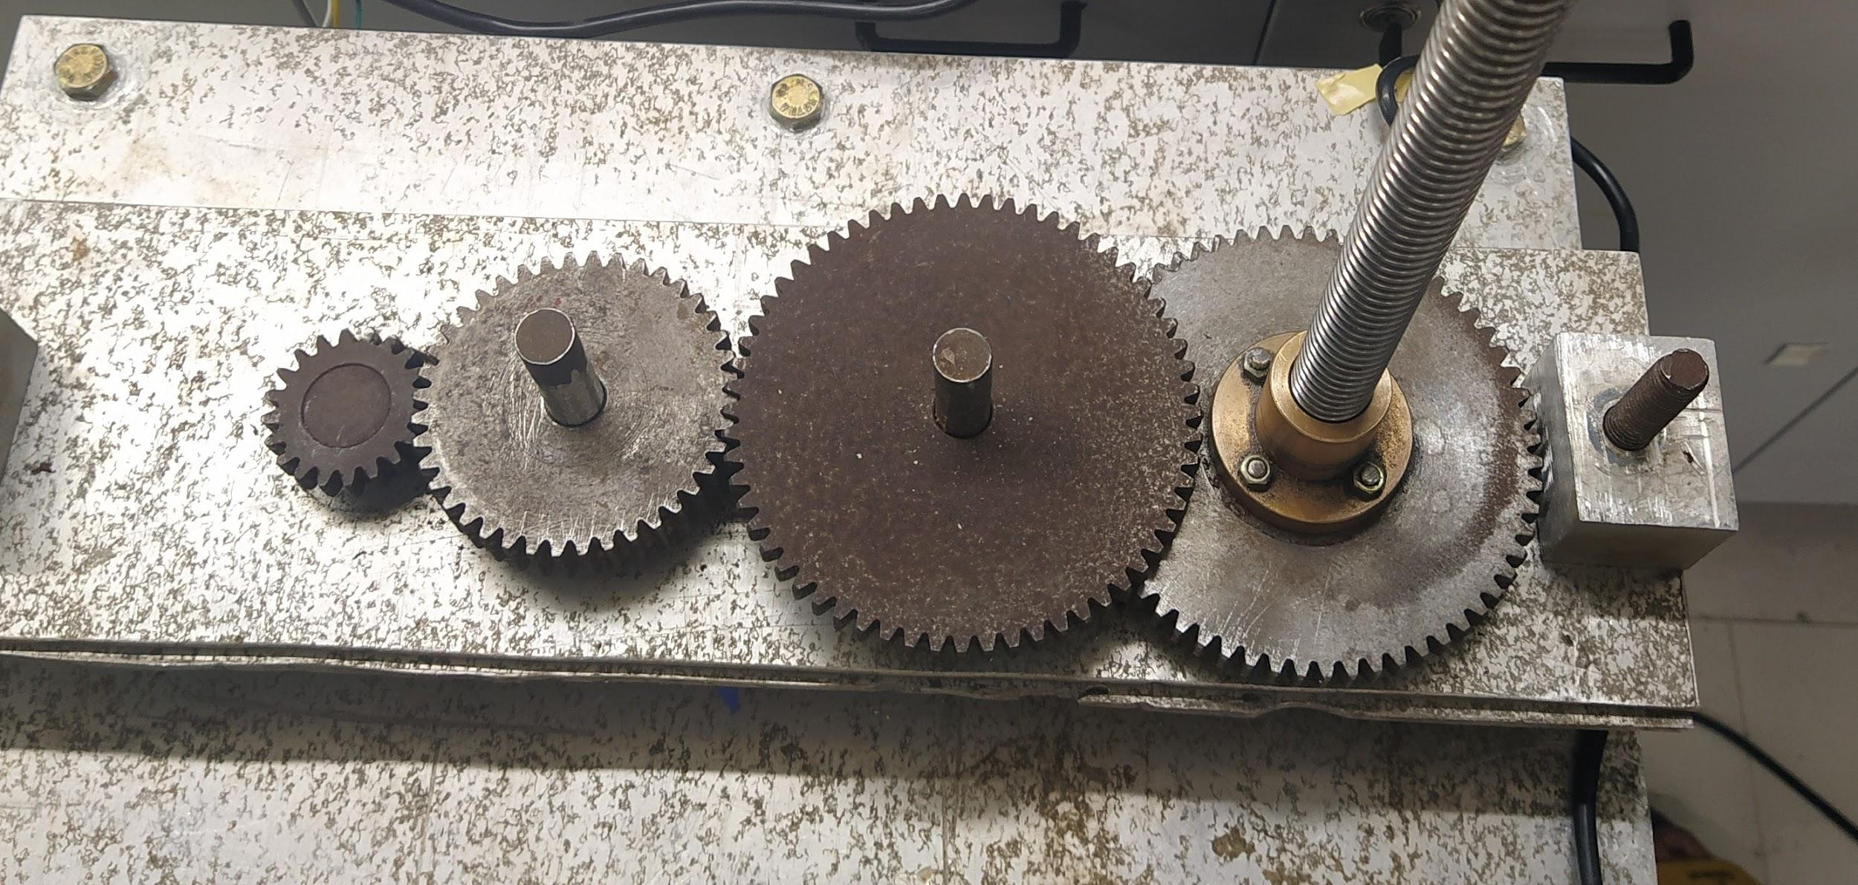
Gear Train used

Slide 8
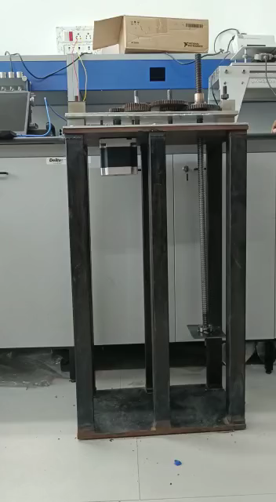
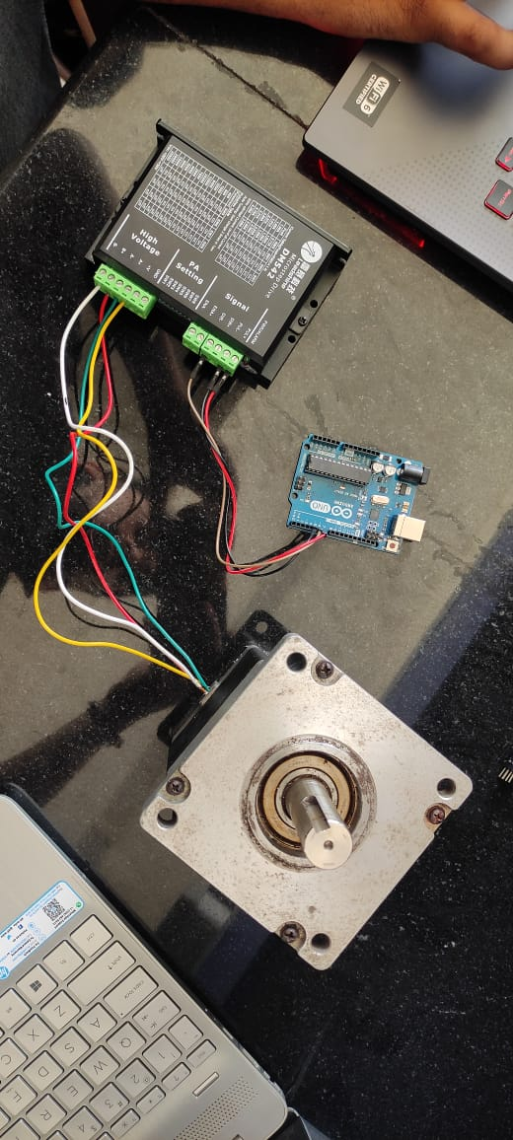
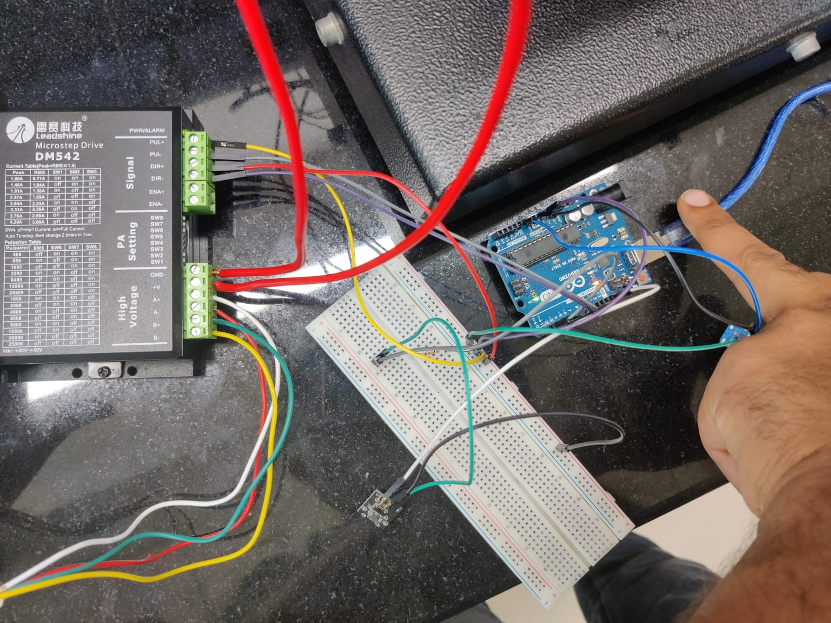
HOW OUR STEPPER MOTER AND GEAR SYSTEM DOING WORK

Slide 9
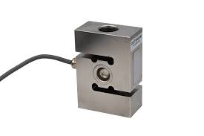
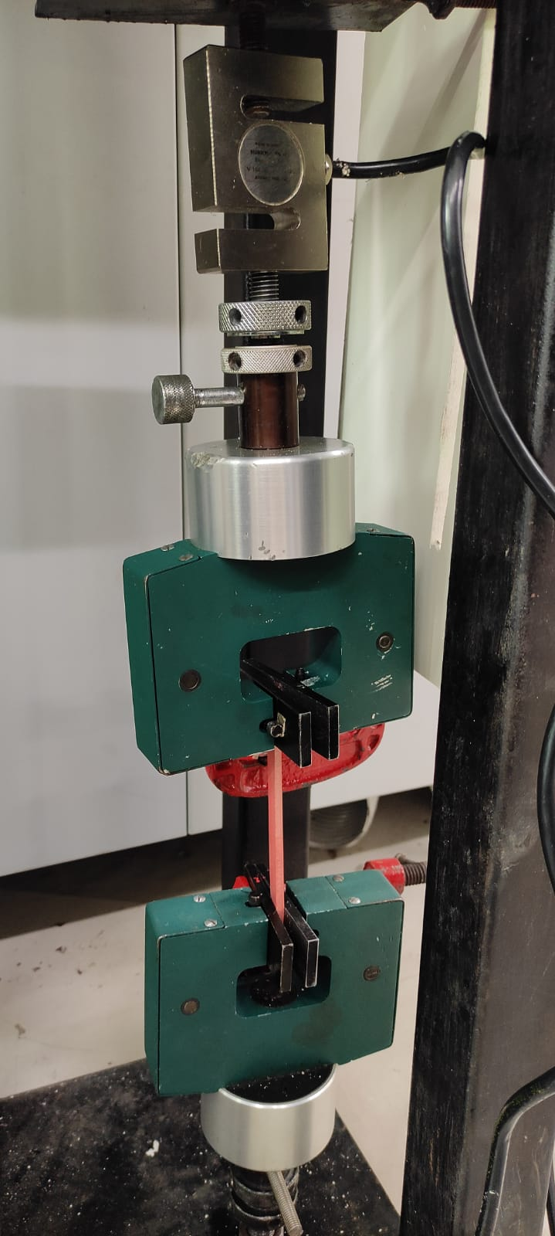
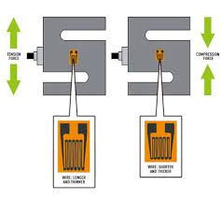
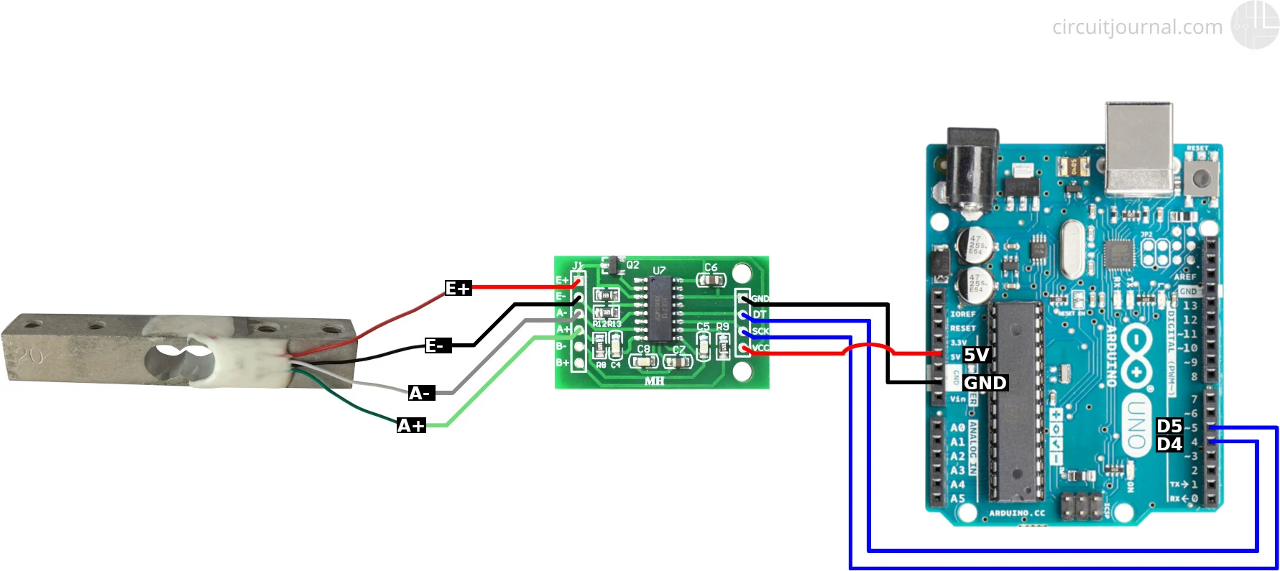
Work of Each component in the machine
For force measurement on the sample due to moving of shaft we use Load cell.
In load cell we have a strain gauge assembly is positioned inside the load cell housing to convert the load acting on them into electrical signals. The weight on the load cell is measured by the voltage fluctuation caused in the strain gauge when it undergoes deformation.

Slide 10

For Strain measurement we uses ImageJ Application
Image stacks, a series of images that share a single window, and it is multithreaded, ImageJ can calculate area and pixel value statistics of user-defined selections and intensity-thresholded objects. Hence It can calculate the distance between two points in a series of an image.

Slide 11
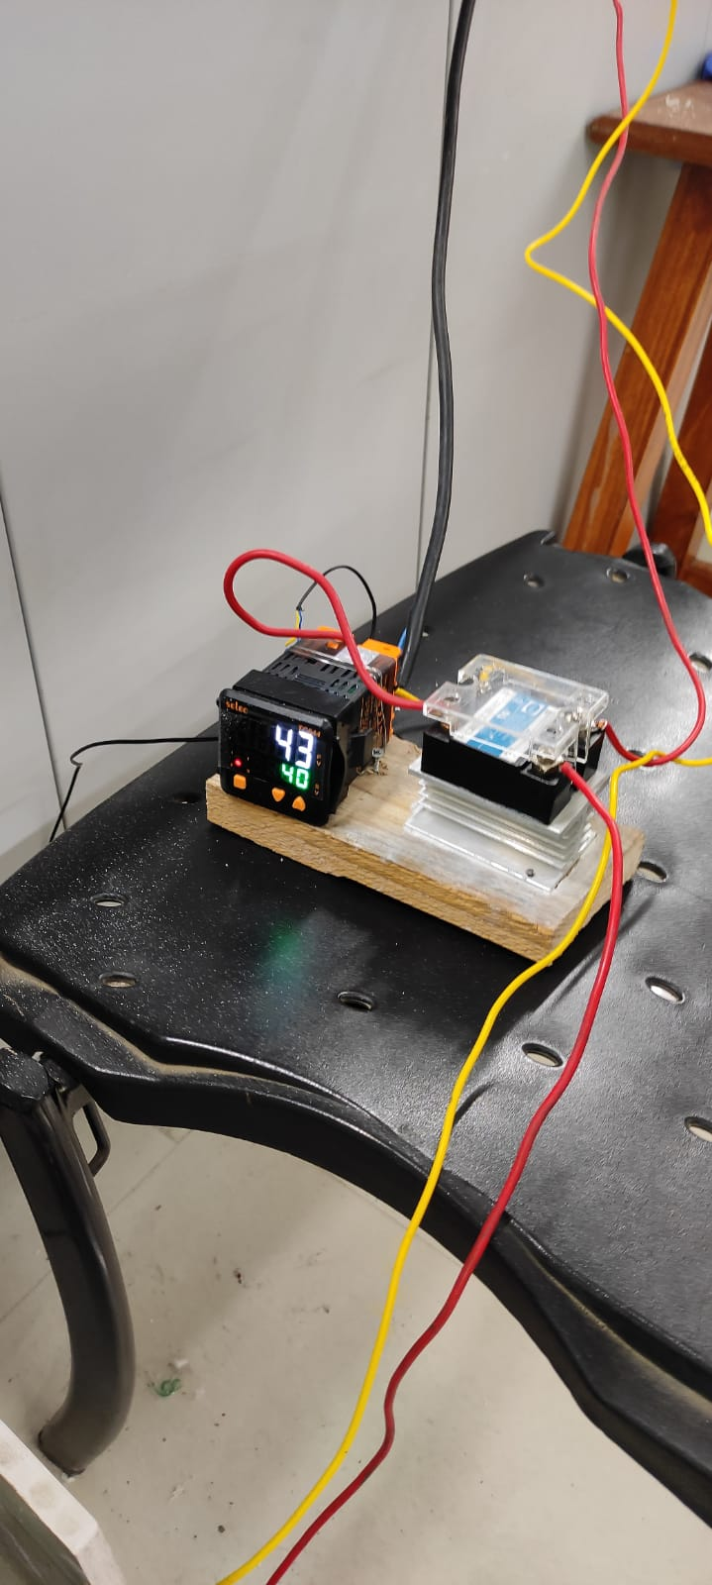
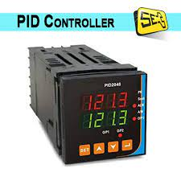
For temperature measurement and maintaining temperature constant
We use PID controller for this work.
The term PID stands for proportional integral derivative and it is one kind of device used to control different process variables like pressure, flow, temperature, and speed in industrial applications. In this controller, a control loop feedback device is used to regulate all the process variables.

Slide 12
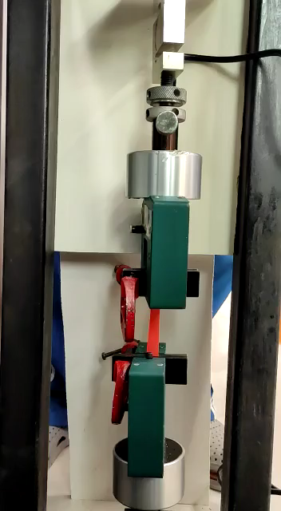
Video of Tensile testing of Material at Room temperature (31 degree Celsius)

Slide 13
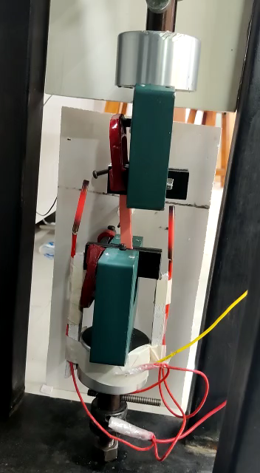
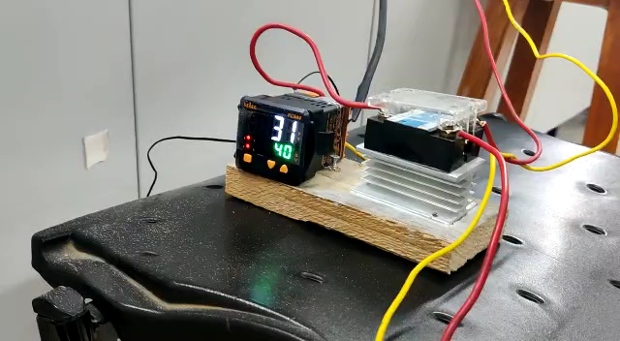
Video of Tensile testing of Material at 43 degree Celsius

